Slide 1
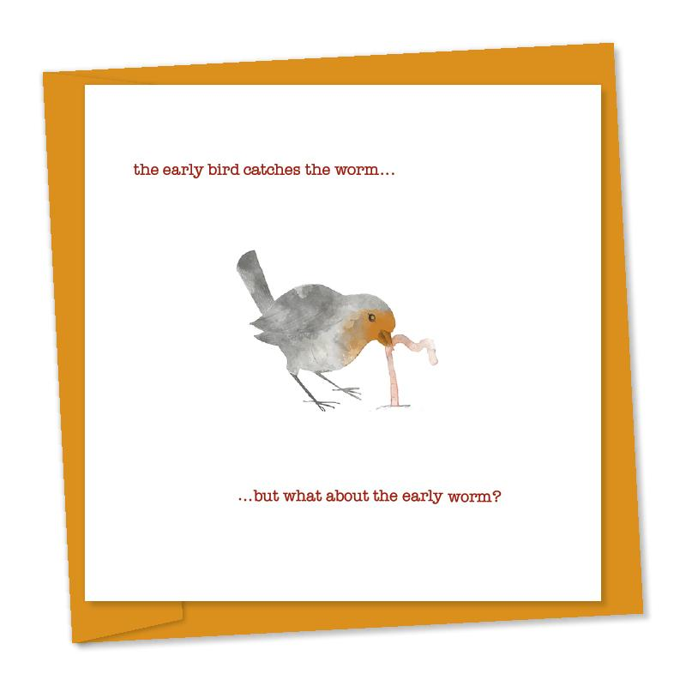

Relative clauses
The early bird catches the worm
↑ ↑
Adjective Noun
But the second mouse gets the cheese.
The bird that is early catches the worm.
↑ ↑
Noun Adjective
Relative clause
Relative clause starts with a relative Pronoun

Slide 2
Relative pronouns/adverbs
Which - for things
Who/whom - for people
Whose - for possession
Where - for place
When - for time
Why - for reason
That - for people and things
Whom usually after prepositions and it´s more formal

Slide 3
Defining
Non-defining
Gives important information
´That´can replace ´who´or ´which´
Can sometimes omit relative pronoun
Has no commas
Gives extra information
Cannot
Cannot
Has commas
Which refers to the whole clause before it

Slide 4
A)In which B)Where C) Which
That´s the place ________ we bought our piano in.
The answer is ´C´
You can write this sentence in 3 ways (where = in which)
That´s the place Where I bought the piano
That´s the place in which I bought the piano (more formal)
That´s the place which we bought the piano in.

Slide 5
A defining relative clause identifies a noun:
Do you know the guy who is talking to Will over there?
I wrote my essay on a photo which was taken by Robert Capa.
If we omit this type of clause, the sentence does not make sense or has a different meaning:
Do you know the guy? (which guy?)
I wrote my essay on a photo. (what kind of photo?)
A non-defining relative clause adds extra information about a noun which already has a clear reference:
The Mona Lisa was painted by Leonardo da Vinci, who was also a prolific engineer and inventor.
If we leave out this type of clause, the sentence still makes sense:
The Mona Lisa was painted by Leonardo da Vinci. (we know who Leonardo da Vinci was)

Slide 6
Sometimes, the use of commas marks a difference in meaning:
The athletes who failed the drug test were disqualified. (defining)
The athletes, who failed the drug test, were disqualified. (non-defining)
The defining relative clause tells us that only those athletes who failed the drug test were disqualified. The sentence implies that there were other athletes who did not fail the drug test and that they were not disqualified.
The non-defining relative clause tells us that all the athletes (mentioned earlier in the context) failed the drug test and that all of them were disqualified.

Slide 7
Omitting the relative pronoun
She would tell stories of wild berries that she'd picked and tell tales of rabbits which she'd seen.
Easy way
Relative pronoun + any noun ( if you have this you don't usually need the relative pronoun
Exceptions
Where Whom In which Whose

Slide 8
He bought me a cigar which was strange
He bought me a cigar, which was strange
It was Red and yellow.
He knows I don´t smoke.

Slide 9
Vladimir Putin
Important information : He´s the president of Russia
Extra : He is bald
Putin, who is bald, is the president of Russia.
Cheeto
Important information : He´s a boy
Extra : He is ugly
Cheeto, who is ugly, is a boy.

